Slide 1
ATAI
Advanced Techniqueof Artificial Intelligence
ATAI
ChongqingUniversity _{AdvancedTechniqueof}
of Technology Artificial Intelligence
Chongqing University of
Technology
Chongqing University ^{ATAI}
_{of Technology} Advanced Techniqueof
Artificial Intelligence
Chongqing University of Technology
Chongqing University of Technology
Self-Expansion of Pre-trained Models with Mixture of Adapters for Continual Learning
Code: https://github.com/huiyiwang01/SEMA-CL
2025.3.31•ChongQing
—— CVPR 2025
Reported by Shunan Yin
1

Slide 2
ATAI
AdvancedTechniqueof
Artificial Intelligence
ATAI
ChongqingUniversity _{AdvancedTechniqueof}
of Technology Artificial Intelligence
ChongqingUniversity of Technology
Motivation
i) Although task-specific expansion of PTMs directly reduces the cross-task conflicts, it causes undesired linear scaling of model size and may impair knowledge transfer/reuse.
ii) Replay-based methods are limited by the size of the memory buffer and may also raise privacy concerns.

Slide 3
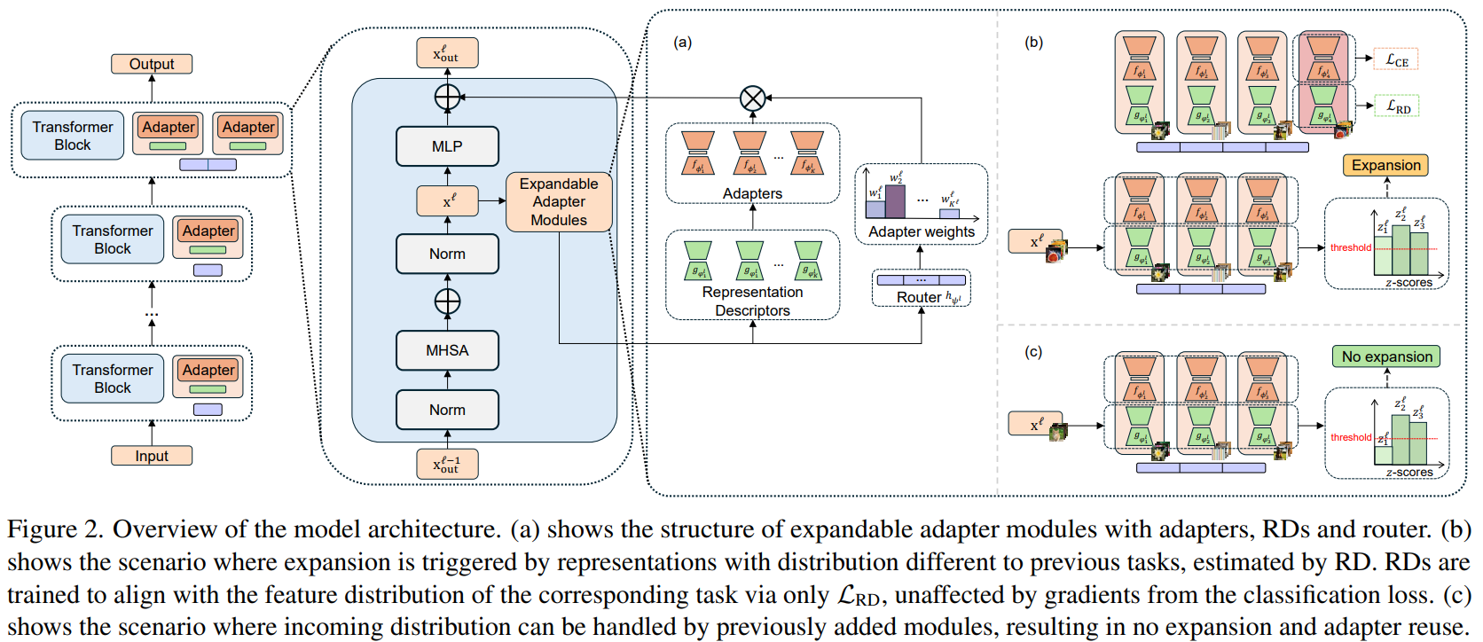
ChongqingUniversity of Technology
ATAI
AdvancedTechniqueof
Artificial Intelligence
ATAI
ChongqingUniversity _{AdvancedTechniqueof}
of Technology Artificial Intelligence
Overview

Slide 4
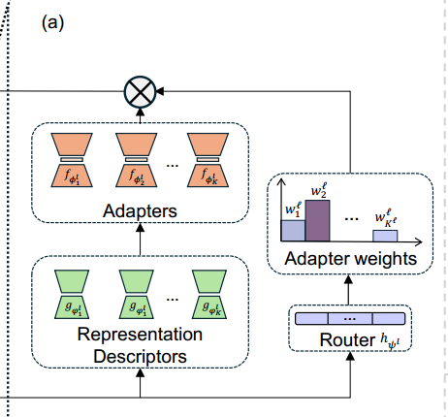
ChongqingUniversity of Technology
Method
ATAI
AdvancedTechniqueof
Artificial Intelligence
ATAI
ChongqingUniversity _{AdvancedTechniqueof}
of Technology Artificial Intelligence

Slide 5
ATAI
AdvancedTechniqueof
Artificial Intelligence
ATAI
ChongqingUniversity _{AdvancedTechniqueof}
of Technology Artificial Intelligence
ChongqingUniversity of Technology
Experiments

Slide 6
ATAI
AdvancedTechniqueof
Artificial Intelligence
ATAI
ChongqingUniversity _{AdvancedTechniqueof}
of Technology Artificial Intelligence
ChongqingUniversity of Technology
Experiments

Slide 7
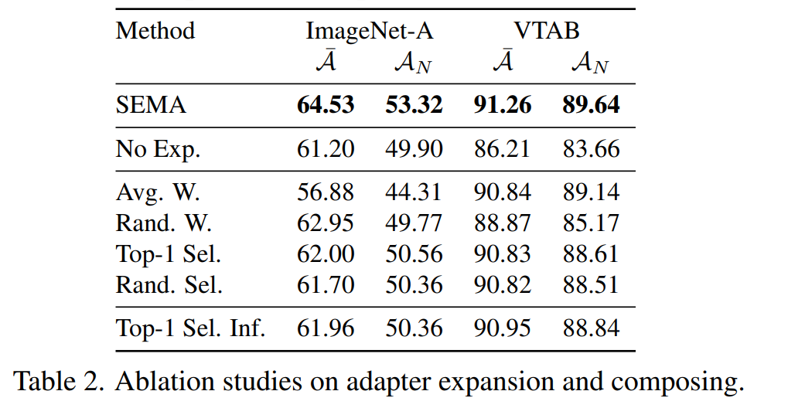
ATAI
AdvancedTechniqueof
Artificial Intelligence
ATAI
ChongqingUniversity _{AdvancedTechniqueof}
of Technology Artificial Intelligence
ChongqingUniversity of Technology
Experiments

Slide 8
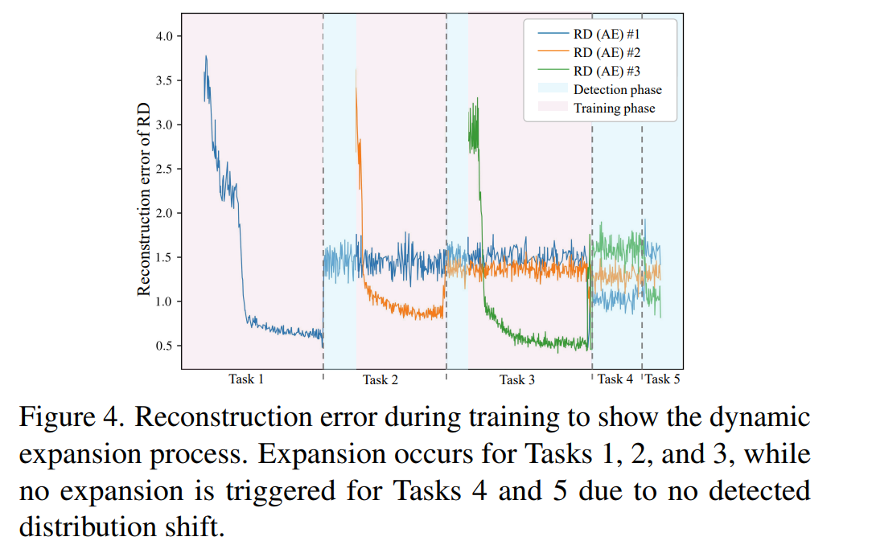
ATAI
AdvancedTechniqueof
Artificial Intelligence
ATAI
ChongqingUniversity _{AdvancedTechniqueof}
of Technology Artificial Intelligence
ChongqingUniversity of Technology
Experiments

Slide 9
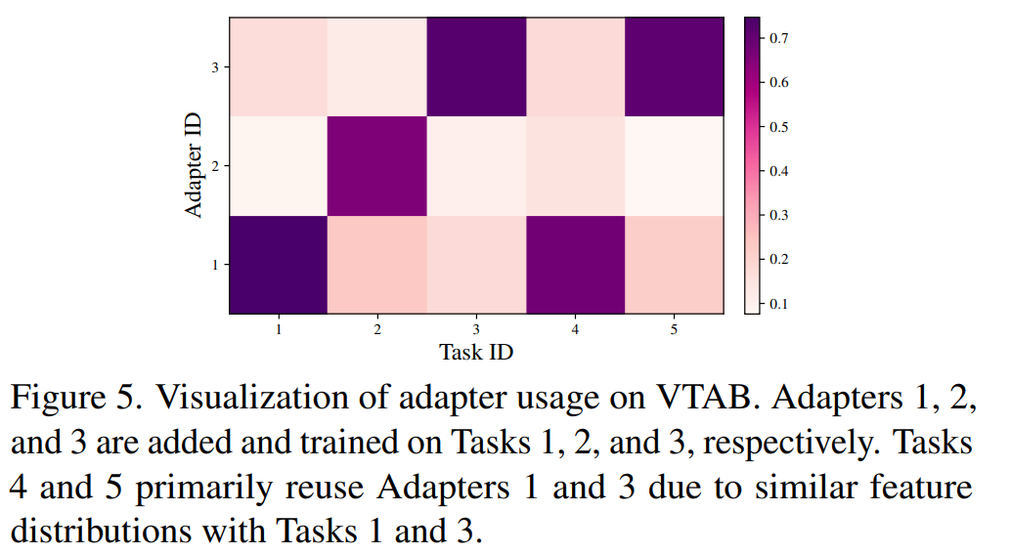
ATAI
AdvancedTechniqueof
Artificial Intelligence
ATAI
ChongqingUniversity _{AdvancedTechniqueof}
of Technology Artificial Intelligence
ChongqingUniversity of Technology
Experiments

Slide 10
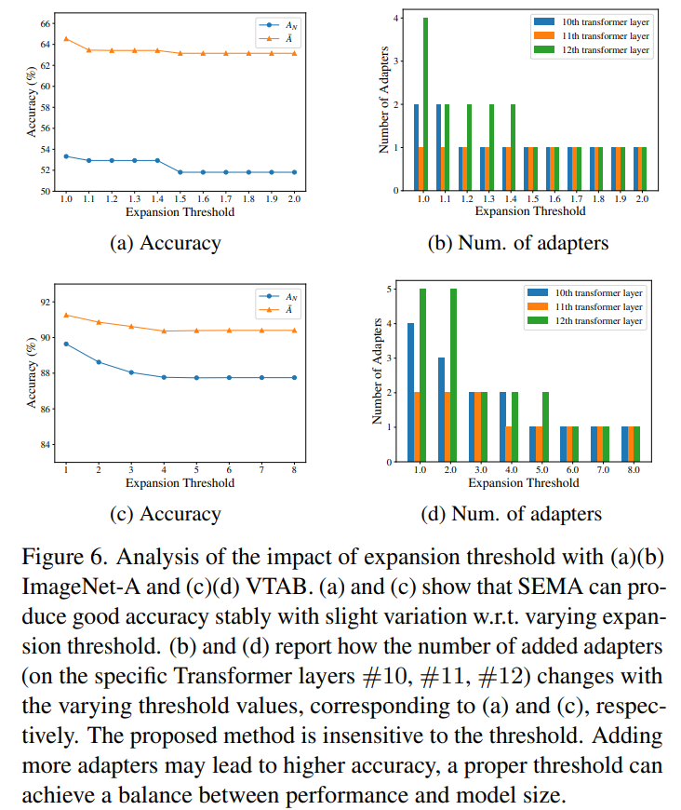
Experiments
ATAI
AdvancedTechniqueof
Artificial Intelligence
ATAI
ChongqingUniversity _{AdvancedTechniqueof}
of Technology Artificial Intelligence
ChongqingUniversity of Technology

Slide 11
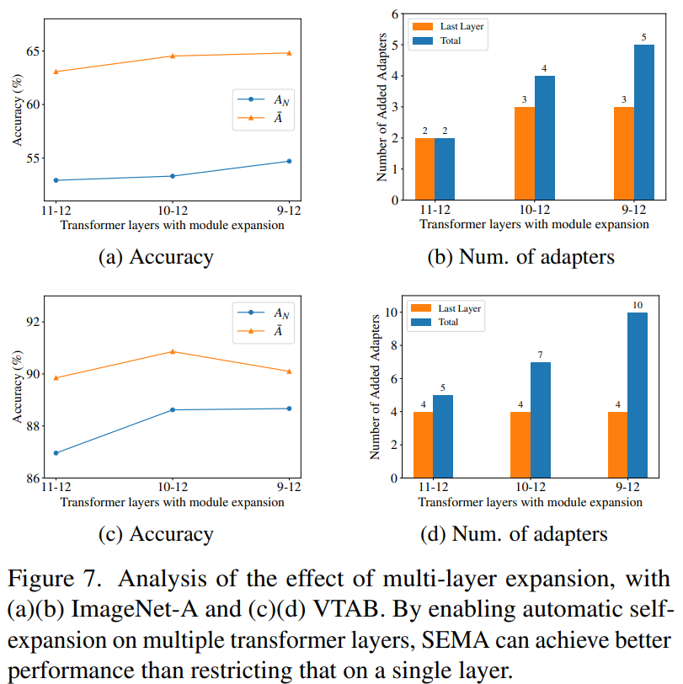
ATAI
AdvancedTechniqueof
Artificial Intelligence
ATAI
ChongqingUniversity _{AdvancedTechniqueof}
of Technology Artificial Intelligence
ChongqingUniversity of Technology
Experiments

Slide 12
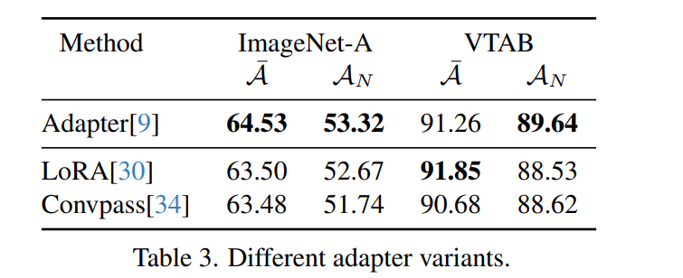
ATAI
AdvancedTechniqueof
Artificial Intelligence
ATAI
ChongqingUniversity _{AdvancedTechniqueof}
of Technology Artificial Intelligence
ChongqingUniversity of Technology
Experiments

Slide 13
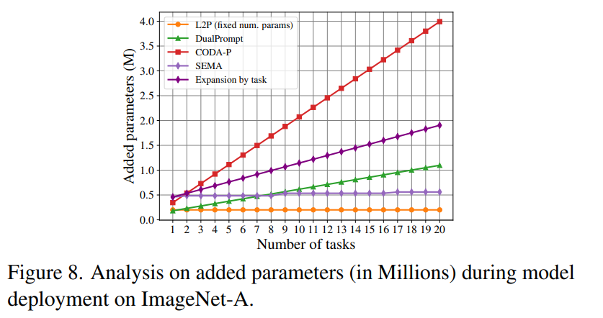
ATAI
AdvancedTechniqueof
Artificial Intelligence
ATAI
ChongqingUniversity _{AdvancedTechniqueof}
of Technology Artificial Intelligence
ChongqingUniversity of Technology
Experiments

Slide 14
ChongqingUniversity of Technology
ATAI
AdvancedTechniqueof
Artificial Intelligence
ATAI
ChongqingUniversity _{AdvancedTechniqueof}
of Technology Artificial Intelligence
Thanks!

